Slide 1
Relation Extraction

Slide 2
Relation extraction from text documents
Relation extraction is a subtask of information extraction where semantic relationships are extracted from natural language text and then classified
Allows acquisition of structured knowledge from unstructured text
The extraction process can be guided or unsupervised

Slide 3
Relation Extraction task
Relation Extraction is the task of predicting attributes and relations for entities in a sentence
Barack Obama was born in Honolulu, Hawaii.
predict each relation - r
(Barack Obama, r1, Honolulu)
(Barack Obama, r2, Hawaii)
(Honolulu, r3, Hawaii)Hawaii)
Ideally - what should be predicted
r1 = was born in
r2 = was born in
r3 = is in

Slide 4
5 approaches
Rule-based RE
Unsupervised RE
Supervised RE
Weakly Supervised RE
Distantly Supervised RE

Slide 5
Rule-based RE
Identified from a large text corpora using hand-crafted patterns
Find triples (X, α, Y) where X, Y are entities and α are words in between
Example - X and Y are entities and α = “is in”
Sentences retrieved - Paris is in France - Delhi is in India etc.
May also retrieve - Taj Mahal is in Agra
Can it retrieve - Qutb Minar is in Delhi from the sentence
The Qutb Minar, an architectural marvel of the 12th century, is in Delhi?
Tedious but Precise
Can work for very restricted context
X

Slide 6
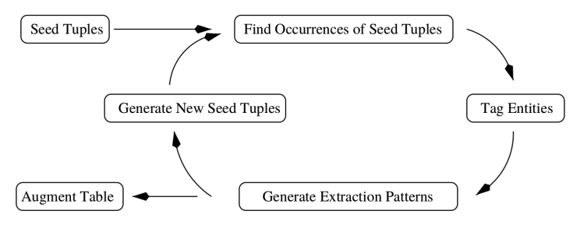
Weakly Supervised Relation extraction
Start out with a set of hand-crafted rules - seed set
Automatically find new ones from the unlabeled text data, through iterative process
E.g. seed={(ORG:IBM, LOC:Armonk), (ORG:Microsoft, LOC:Redmond)} → entities have relation “based in”
“IBM shut down an office in Hursley” - X
TCS is_located_in DELHI
Google Labs has_office _in Bangalore

Slide 7
Almost Unsupervised RE
Extract relations from text without having to label any training data
Use patterns and knowledge about language
Provide a set of seed tuples or some rules to capture different types of relations in the text relying on a set of very general constraints and heuristics
“rules” are at a more general level
These systems tend to require less supervision in general.

Slide 8
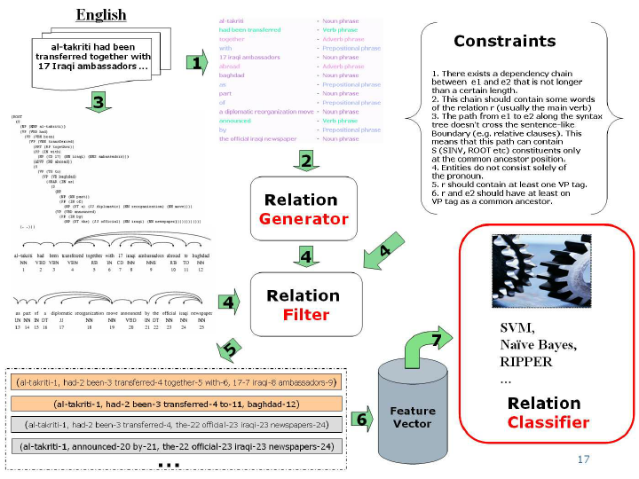
Unsupervised RE
Statistical validation of relation

Slide 9
Relation extraction pipeline
Works better if text is processed by other NLP modules first
Features that are annotated:
context / domain words,
part-of-speech tags,
dependency path between entities,
NER tags, tokens,
proximity distance between words

Slide 10
TextRunner RE algorithm
Step 1 - Train a self-supervised classifier on a small corpus
For each parsed sentence, find all pairs of noun phrases (X, Y) with a sequence of words r connecting them. Label them as positive examples if they meet all of the constraints, otherwise label them as negative examples.
Map each triple (X, r, Y) to a feature vector representation (e.g. incorporating POS tags, number of stop words in r, NER tag, etc.)
Train a binary classifier to identify trustworthy candidates - CRF based cllassifier

Slide 11
TextRunner RE algorithm
Step 2 - Pass over the entire corpus and extract possible relations
Fetch potential relations from the corpus
Keep/discard candidates depending on whether the classifier considers them as trustworthy or not

Slide 12
TextRunner RE algorithm
Step 3 . Rank-based assessment of relations based on text redundancy
Normalize (omit non-essential modifiers) and merge relations that are same
Count the number of distinct sentences the relations are present in and assign probabilities to each relation
Learning from results - REVERB
Takeaway - (verb | verb particle | verb word* particle) covers about 85% of verb-based relation phrases in English.

Slide 13
Open IE - relation extraction
Open Information Extraction (Open IE) system - Runs over sentences and creates extractions that represent relations in text - (Subj, Predicate / relation, Object)
The U.S. president Barack Obama gave his speech on Tuesday and Wednesday to thousands of people
(Barack Obama, is the president of, United States)
(Barack Obama, gave, his speech)
(Barack Obama, gave his speech, on Tuesday)
(Barack Obama, gave his speech, on Wednesday)
(Barack Obama, gave his speech, to thousands of people)
Many binary relations can be there in a single sentence
http://openie.cs.washington.edu/.

Slide 14
Key tasks
Detecting boundaries of Relations
Detecting boundaries of arguments
Example 1 - Yakub flew from London to Seattle - complex relations
Ideally - (Yakub, flew, from London, to Seattle) - not typically (e1 r e2) - relation - n-ary relation
Example 2 - Early scientists believed that earth is the center of the universe
What is the key assertion?
Extracting - (earth, is the center of, the universe) will be inappropriate,
Sentence isn’t asserting that - it is merely noting that this tuple was believed by early scientists.

Slide 15
Using Sentence structures
Semantic Role Labeling - Analyzes the output of a state-of-the-art PropBank-trained SRL system
Analyzes the hierarchical structure between semantic frames to construct multi-verb open relation phrases and nested relational tuples.
For example sentence - “John refused to visit a Vegas casino”
Two frames provided by SRL - a ‘refuse’ frame and a ‘visit’ frame
For the ‘visit’ frame, the argument-1 is ‘John’ and argument-2 is ‘a Vegas casino’
http://sato.fm.senshu-u.ac.jp/frameSQL/fn2_15/notes/
https://openie.allenai.org/

Slide 16
Publications
Michele Banko, Michael Cafarella, Stephen Soderland, Matt Broadhead, and Oren Etzioni. Open information extraction from the web. In IJCAI, 2007.
Janara Christensen, Mausam, Stephen Soderland, and Oren Etzioni. An analysis of open information extraction based on semantic role labeling. In KCAP, 2011.
Oren Etzioni, Anthony Fader, Janara Christensen, Stephen Soderland, and Mausam. Open information extraction: The second generation. In IJCAI, 2011.
Anthony Fader, Stephen Soderland, and Oren Etzioni. Identifying relations for open information extraction. In EMNLP, 2011
Harinder Pal and Mausam. Demonyms and compound relational nouns in nominal Open IE. In AKBC, 2016.
Aman Anand, Ashish Mittal, Mausam, Ganesh Ramakrishnan, and Sunita Sarawagi. Numerical relation extraction with minimal supervision. In AAAI, 2016.
A fundamental drawback of Open IE is its lack of relation normalization..

Slide 17
Supervised Machine Learning
Extract “meaningful / significant / important” relations from text only
Use prior knowledge to decide what is to be extracted
Example - From bio-medical literature -
Extract chemical and disease relations from unstructured biomedical literature

Slide 18
Problem definition
Given a context sequence
𝐶 = (𝑤1𝑐, 𝑤2𝑐, …, 𝑤𝑛𝑐)
Entities
𝑒1 = (𝑤𝑠𝑒1𝑐, 𝑤𝑠𝑒1+1𝑐 ,…, 𝑤𝑒𝑒1𝑐) and 𝑒2 =(𝑤𝑠𝑒2𝑐,𝑤𝑠𝑒2+1𝑐,…,𝑤𝑒𝑒2𝑐)
Relation extraction(RE) aims to validate the existence of the relation r between e1 and e2, where 𝑟∈𝑅
𝑅 = predefined relation list
For chemical-induced disease (CID) the relation r is ‘induce’ between a chemical name and a disease name

Slide 19
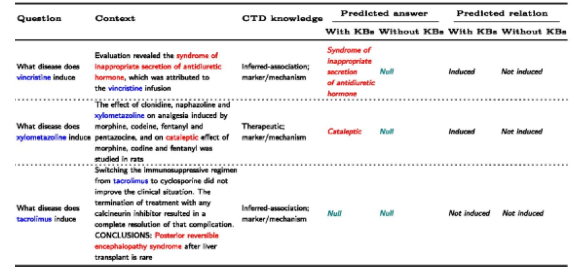

Slide 20
Challenges
Sentences can be arbitrarily complex in structure
A relation may be expressed in many different ways
Long-distance + multi-sentence dependencies may exist
Compound sentences - presence of single versus multiple entities as arguments

Slide 21
Supervised Relation extraction
1st step - Manually label the text data i.e. a sentence is relevant or not for a specific relation type. - Context
E.g. for the “CEO” relation: -
“Apple CEO Steve Jobs said to Bill Gates.” is relevant
“Bob, Pie Enthusiast, said to Bill Gates.” is not relevant (doesn’t have CEO)
2nd way - Manually label the relevant sentences as positive/negative if they are expressing the relation. E.g. “Apple CEO Steve Jobs said to Bill Gates.”: (Steve Jobs, CEO, Apple) is positive (Bill Gates, CEO, Apple) is negative
Learn a binary classifier to determine if the sentence is relevant for the relation type
Use the classifiers to detect relations in new text data.
Use the classifiers to detect relations in new text data.
Expensive to label examples

Slide 22
Distant Supervision
Supervision without manually labeling sentences
Supervision comes from instances that are valid and verified
Instances are a part of a Knowledge Base / Knowledge Graph
Use them to extract more instances from new text using ML / DL
Validate
Add valid instances to Knowledge Base
A knowledge graph is a graph structured Knowledge Base used to store interlinked descriptions of entities

Slide 23
Knowledge graph / Knowledge Base examples
YAGO: A High-Quality Knowledge Base storing general knowledge about people, cities, countries, movies, and organizations
Freebase - a large collaborative knowledge base consisting of data composed mainly by its community members - Powered Metaweb that was acquired by Google - Google's Knowledge Graph is powered in part by Freebase
DBpedia - DBpedia 6.0 million entities - 1.5M persons, 810k places, 135k music albums, 106k films, 20k video games, 275k organizations, 301k species and 5k diseases

Slide 24
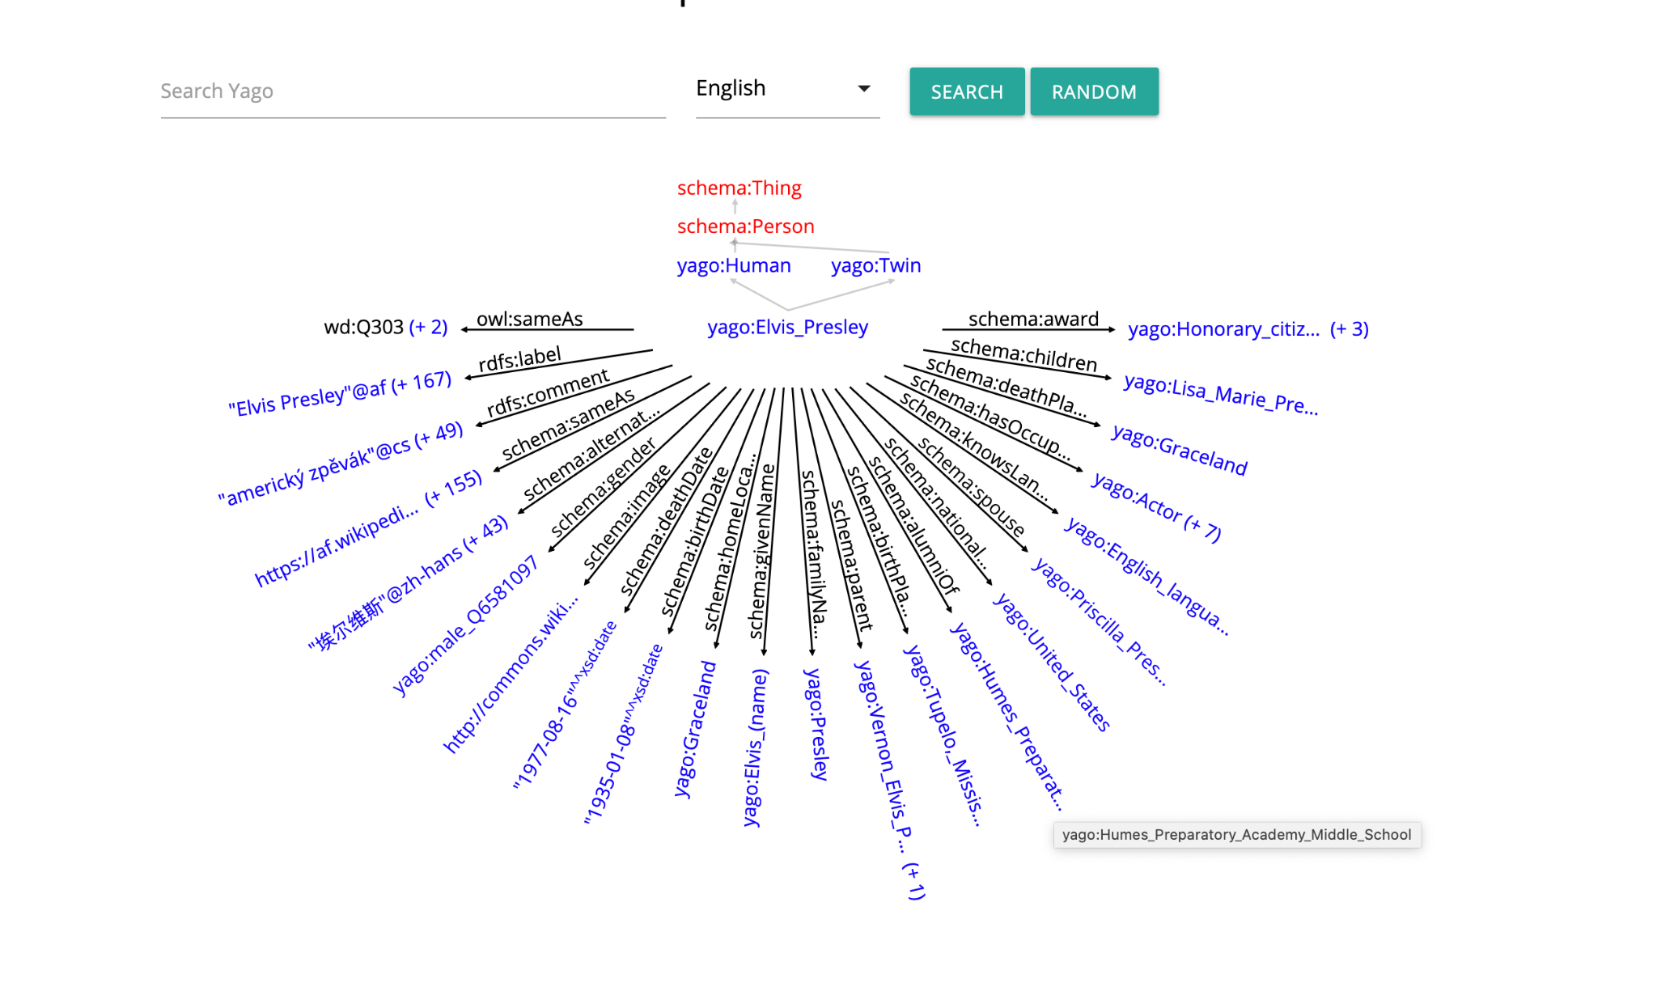
YAGO

Slide 25
Biomedical Ontologies / Knowledge Graph
Gene Ontology (GO) - consists of three controlled vocabularies for cellular components, molecular functions, and biological processes
Drug-Target Ontology - Formalize knowledge about drug targets with a focus on the current IDG protein families.
Human Phenotype Ontology - Abnormalities and their Gene associations

Slide 26
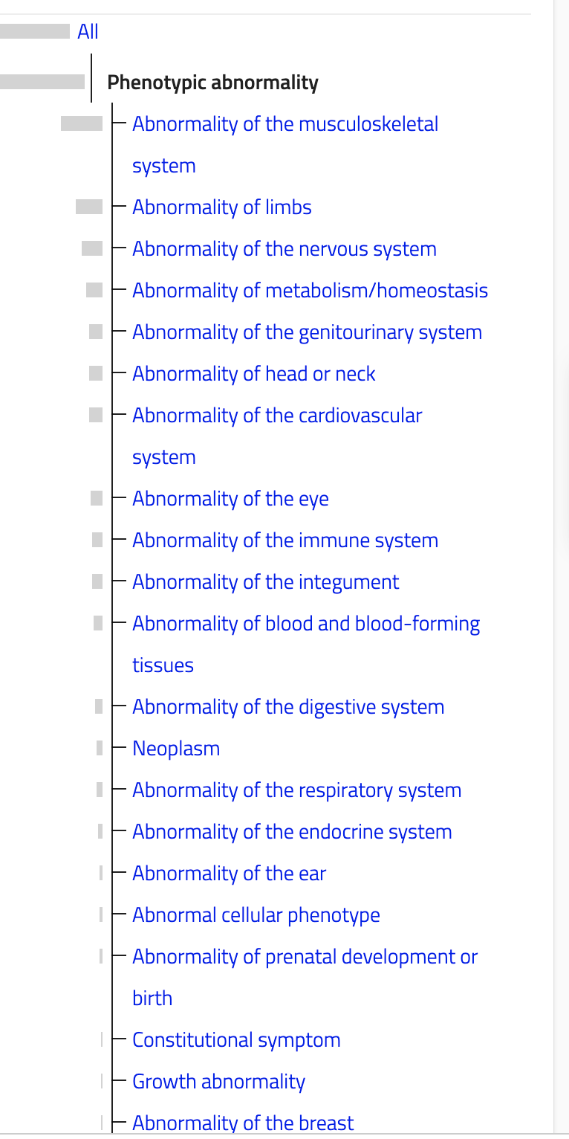
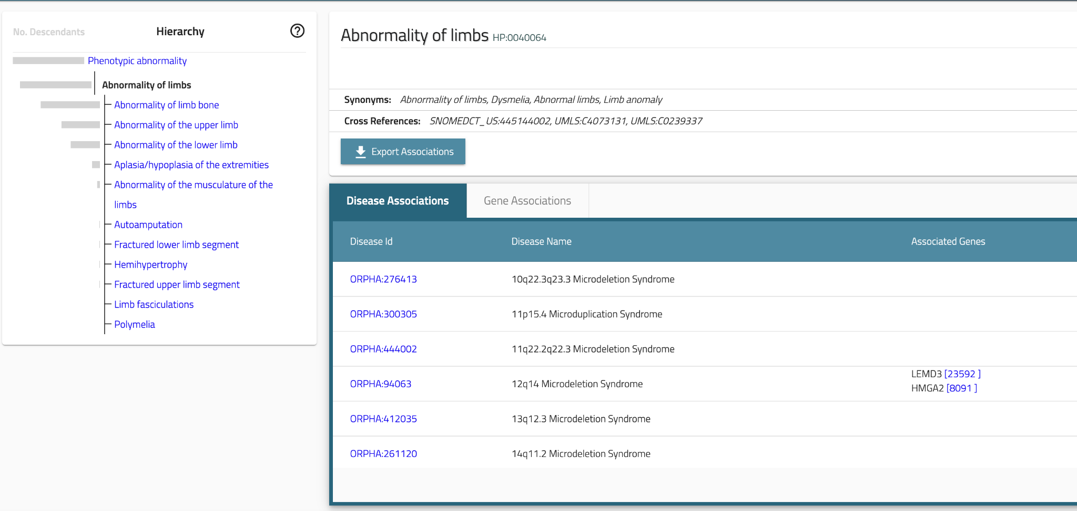
Human Phenotype Ontology

Slide 27
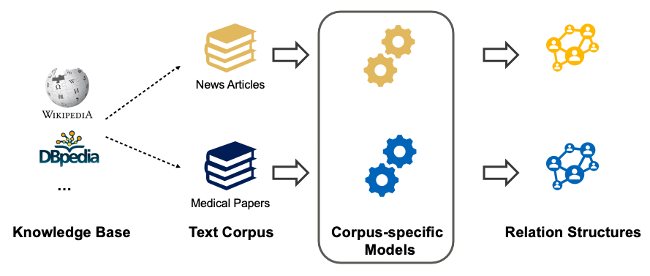
Distant Supervision
Combining Seed-set rules and Supervision - with seed set picked up from an existing KG - Wikipedia, DBpedia, Wikidata, Freebase, Yago.
For each relation type of interest in the KB
For each tuple of this relation in the KB
Select sentences from unlabeled text data that match these tuples (both words of the tuple is co-occurring in the sentence), and assume that these sentences are positive examples for this relation type
Extract features from these sentences (e.g. POS, context words, etc)
Train a supervised classifier on this
Less manual effort - but NOISY
Careful validation before use

Slide 28
How does the Learning happen
If a pair of entities occurs in N sentences - all features from all N sentences are stored
Relation - (Film, Director)
[Steven Spielberg]’s film [Saving Private Ryan] is loosely based on the brothers’ story.
Allison co-produced the Academy Awardwinning [Saving Private Ryan], directed by [Steven Spielberg]...
Each sentence has a xi features extracted from it
The entity pair will have 𝚺xi features associated with it
A regression classifier predicts a relation name for each entity pair based on the features from all of the sentences in which it appeared

Slide 29
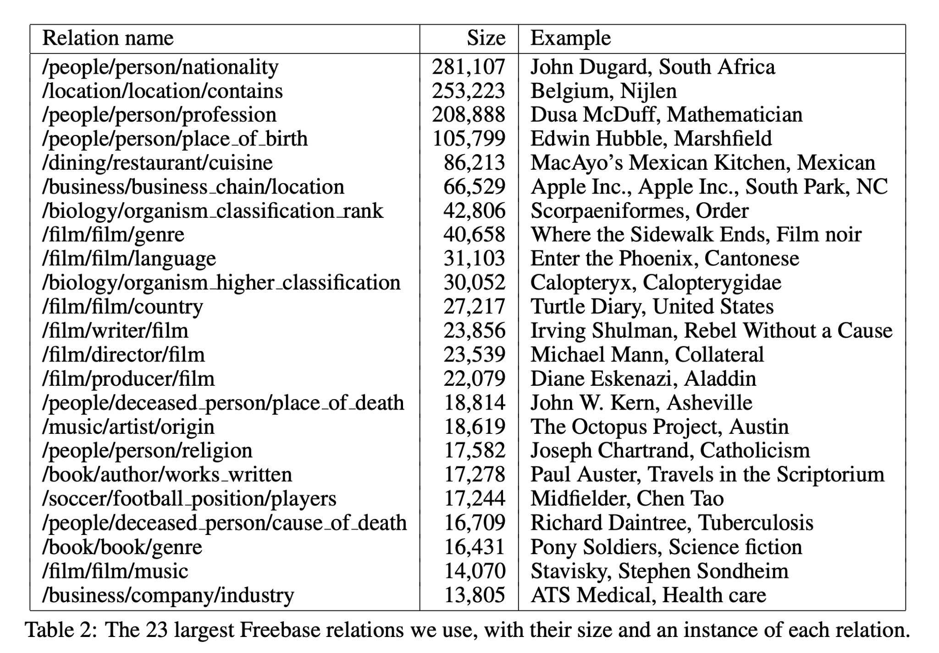
Lexical features
• The sequence of words between the two entities
• The part-of-speech tags of these words
• A flag indicating which entity came first in the sentence
• A window of k words to the left of Entity 1 and their part-of-speech tags
• A window of k words to the right of Entity 2 and their part-of-speech tags
Syntactic features
A dependency path between the two entities • For each entity, one ‘window’ node that is not part of the dependency path
Distant supervision for relation extraction without labeled data - https://aclanthology.org/P09-1113.pdf

Slide 30
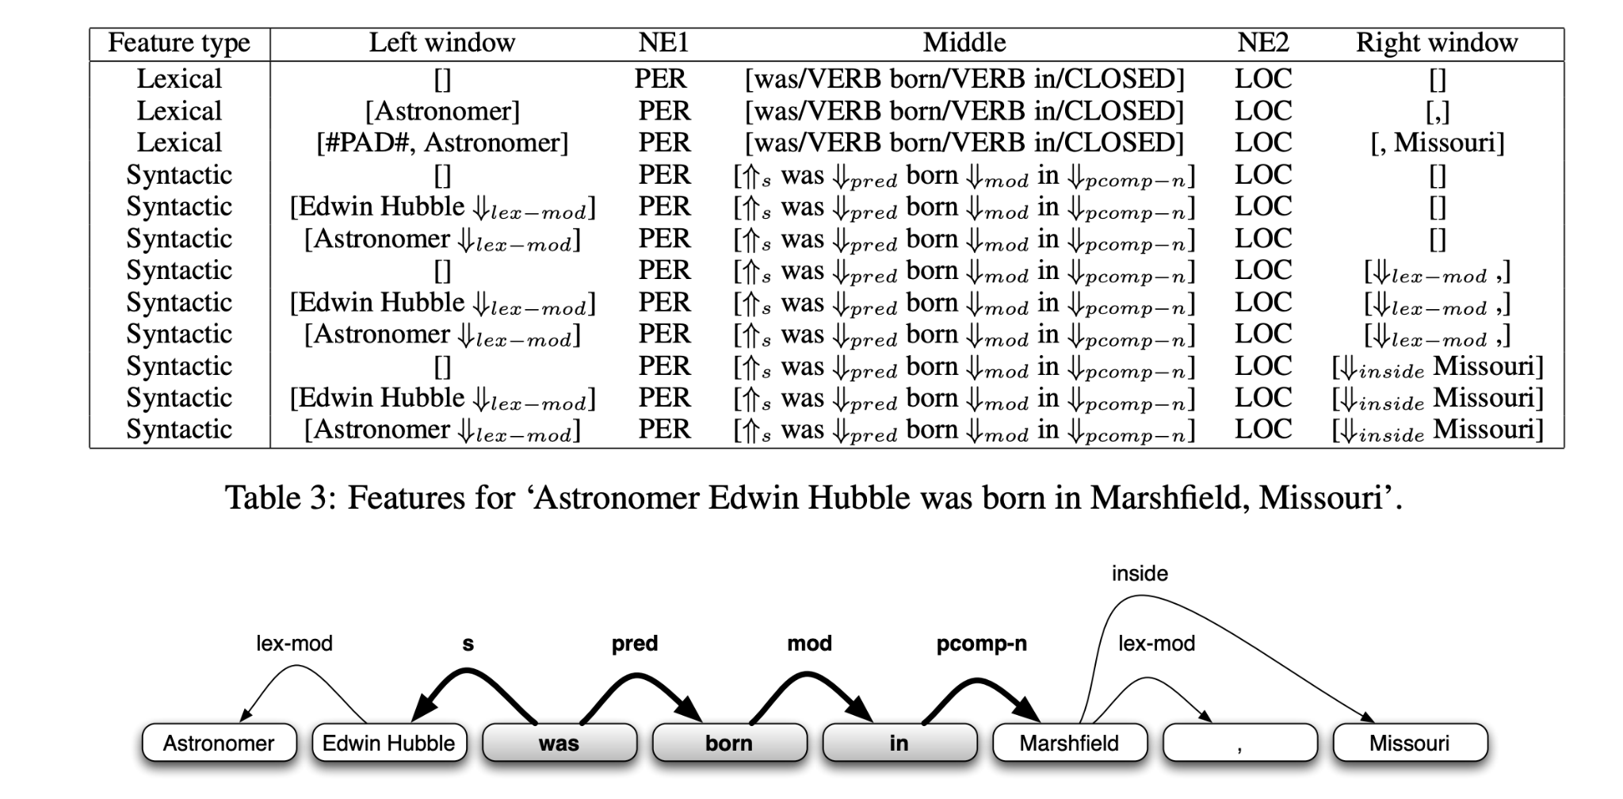
Sample table

Slide 31
Training
Negative Samples - randomly selected sentences with two entities - assumed not to be related
Wikipedia articles - 800,000 Wikipedia articles
Half of the instances of each relation used in training - half held out for testing
400,000 different articles in the testing phase

Slide 32
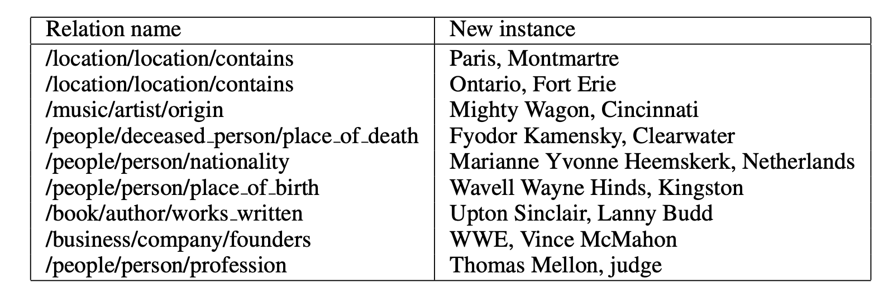
New instances not in Wikipedia

Slide 33
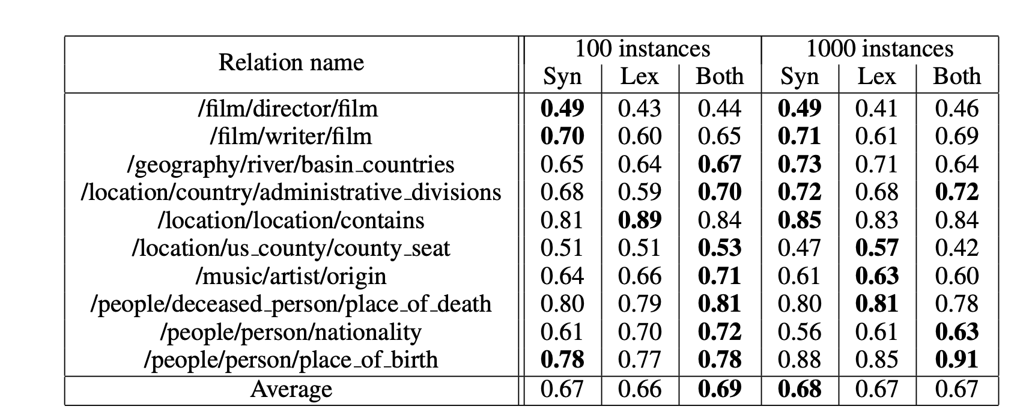
Feature importance

Slide 34
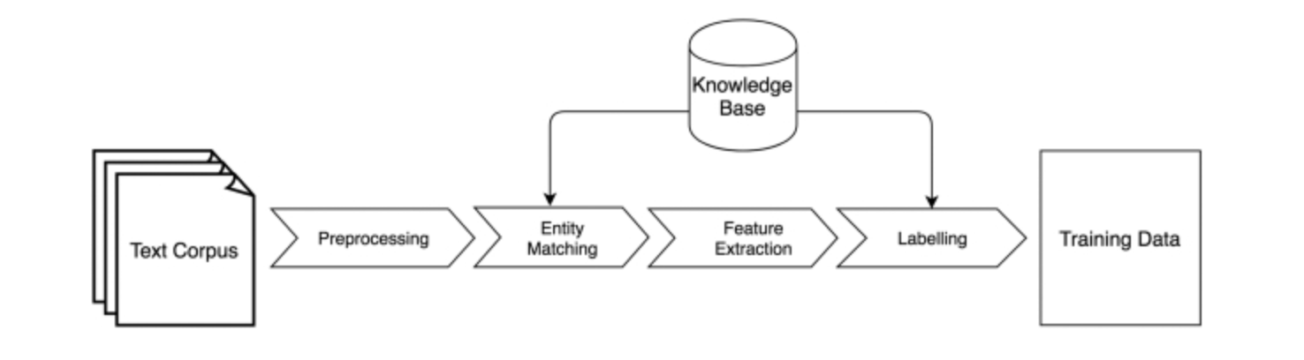
Pipeline for Distant Supervision

Slide 35
Multi-instance Learning
Assuming only that at least one of the sentences containing e1 and e2 are expressing r(e1, e2)
Yields a substantial improvement in extraction performance - especially from non-focussed corpus - like News, Reports etc.
Can handle overlapping relations -
Founded(Jobs, Apple) and CEO-of(Jobs, Apple) - both are true
MultiR - proposed in
Knowledge-Based Weak Supervision for Information Extraction of Overlapping Relations - https://aclanthology.org/P11-1055.pdf

Slide 36
Graphical Model for Multi-instance Learning
Graphical model -
Handle accurate sentence-level predictions as well as corpus -level extractions
Inference process - reduces to weighted set cover, for which it uses a greedy approximation with worst case running time O(|R| · |S|) where R is the set of possible relations and S is largest set of sentences for any entity pair

Slide 37
Corpus and Sentential extraction
Aggregate extraction
Inputs, Σ, a set of sentences comprising the corpus, and an extraction model;
Output - a set of ground facts, I, such that each fact r(e) ∈ I is expressed somewhere in the corpus.
Sentential extraction - takes the same input and likewise produces I, but in addition it also produces a function, Γ : I → P(Σ), which identifies, for each r(e) ∈ I, the set of sentences in Σ that contain a mention describing r(e)
Sentence-level extraction must justify each extraction with every sentence which expresses the fact.

Slide 38
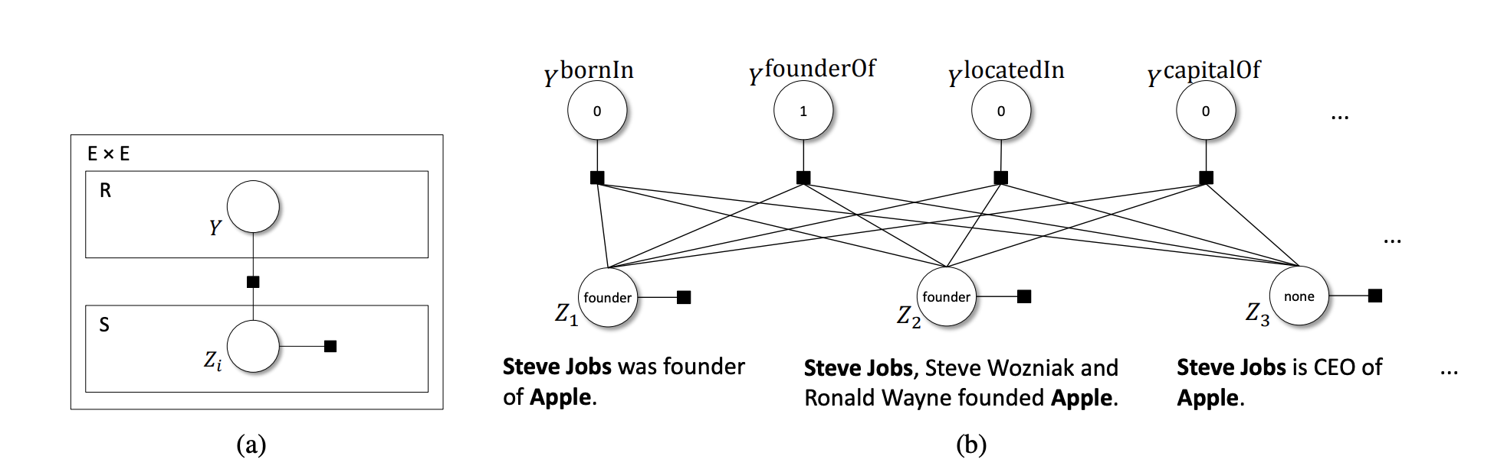
Joint, Conditional Extraction Model

Slide 39
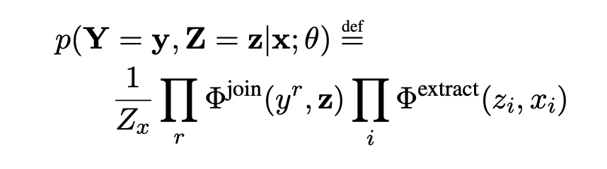
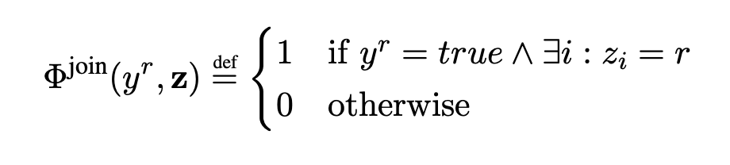
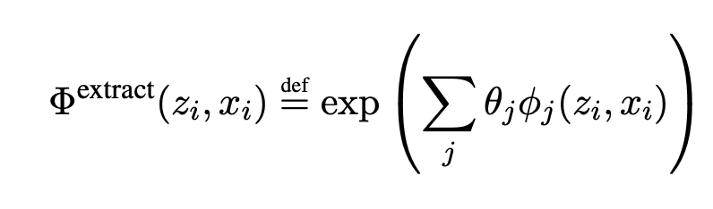
Joint probability
Y is binary vector of r random variables, one for each r ∈ R
Z is vector of Zi variables, one for each sentence xi

Slide 40
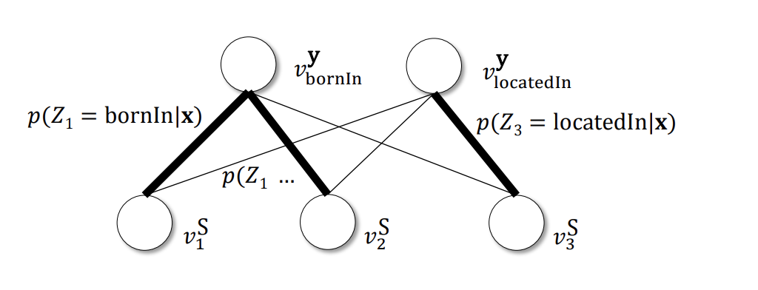
Graph Matching Problem
Goal - select a subset of the edges which maximizes the sum of their weights, subject to each node being incident to exactly one edge, and each relation name node is incident to at least one edge.

Slide 41
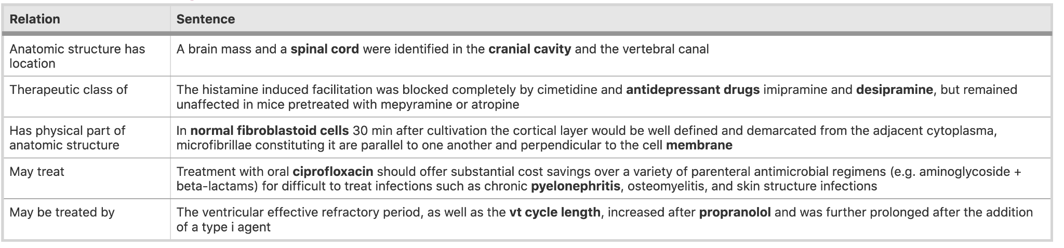
Deep Learning Models
Reduce dependence on NLP tools

Slide 42
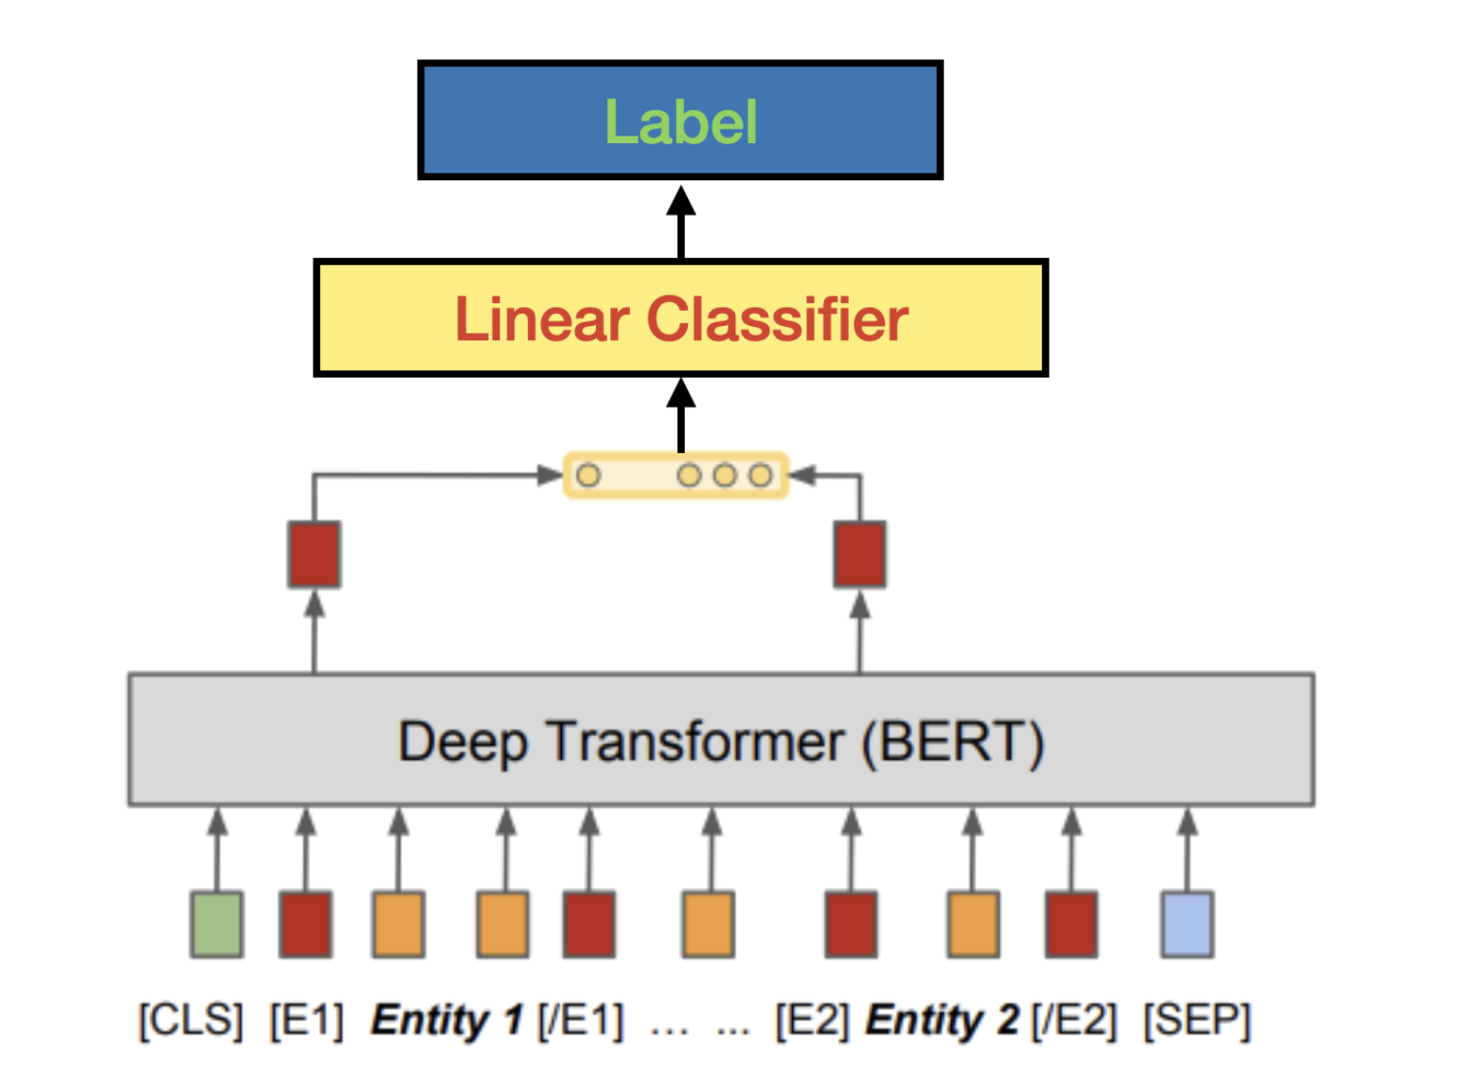
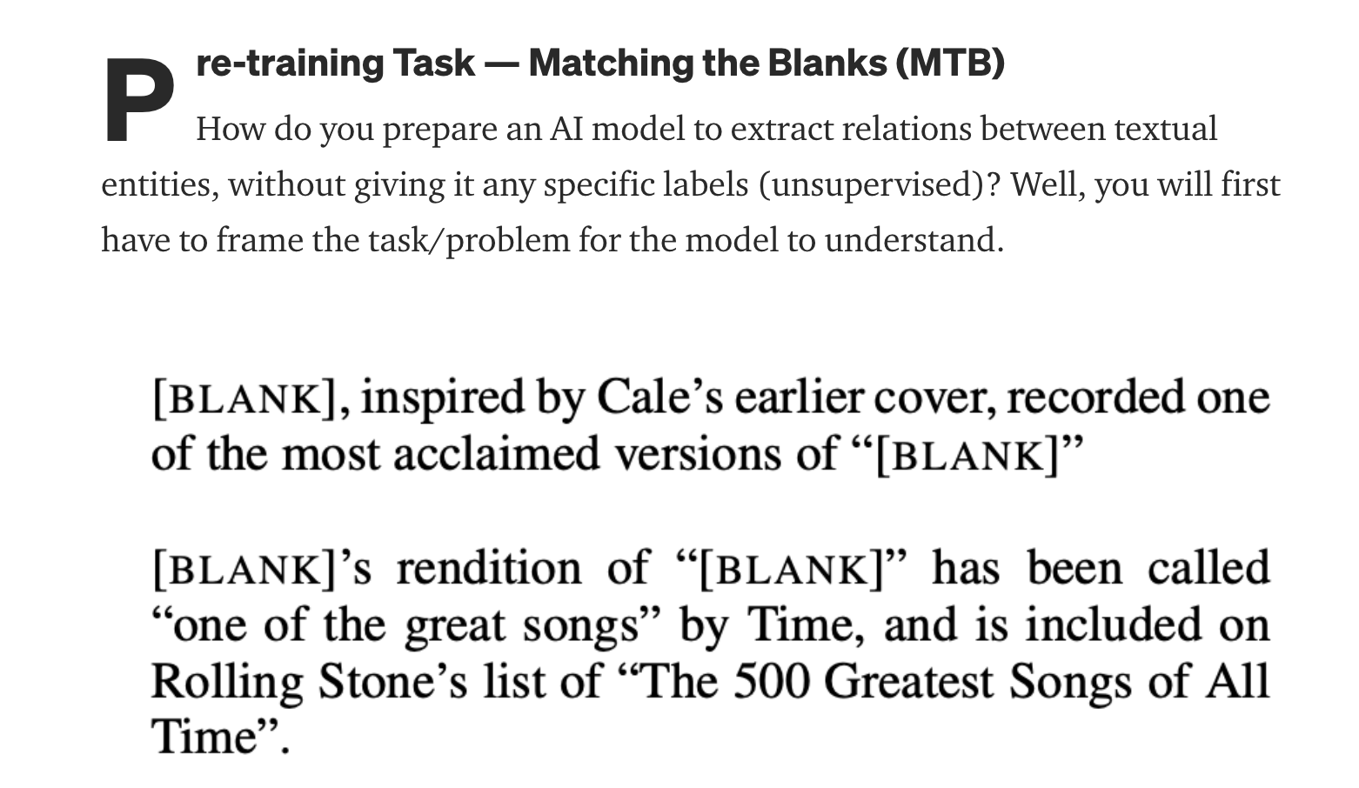
Adding a Linear Classifier
Goal is to learn a function hr = fθ(r) that maps the relation statement to a fixed-length vector hr ∈ Rd that represents the relation expressed in x between the entities marked by s1 and s2

Slide 43
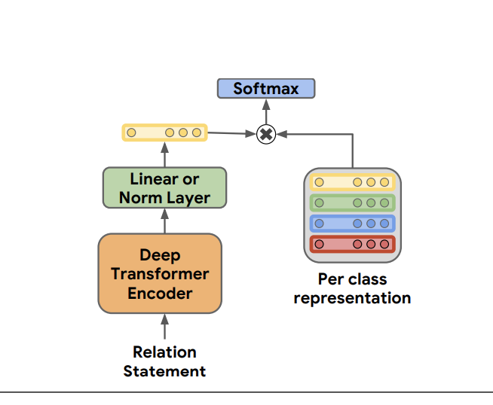
Matching the Blanks: Distributional Similarity for Relation Learning
Special markers were used to mark entities of interest in the input to BERT
CLS is used as the fixed length representation of a relation - that will be used for classification
https://arxiv.org/pdf/1906.03158.pdf

Slide 44
Learning - matching the blank
Assumption - there is high degree of redundancy in web text - and each relation between an arbitrary pair of entities is likely to be stated multiple times
r = (x, s1, s2) is more likely to encode the same semantic relation as r 0 = (x 0 , s 0 1 , s 0 2 ) if s1 refers to the same entity as s 0 1 , and s2 refers to the same entity as s 0 2
New method of learning - matching the blanks (MTB)
MTB learns relation representations that can be used without any further tuning for relation extraction

Slide 45
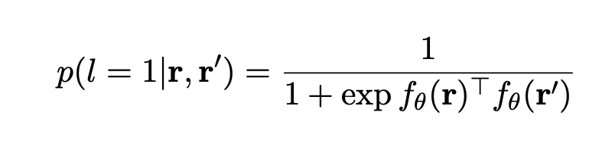
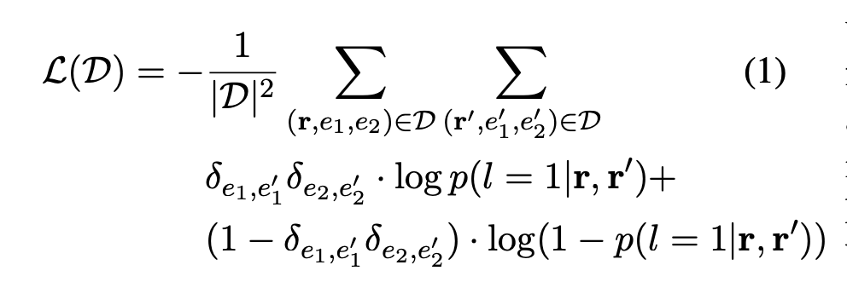
Minimize loss using inner product

Slide 46
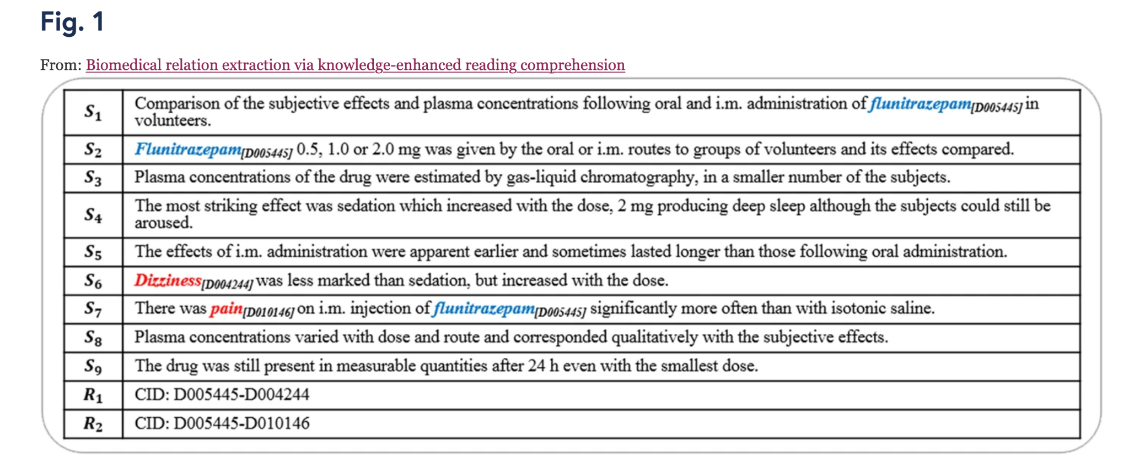
Example

Slide 47
Multi-Instance-Learning (MIL)
Widely-used framework used by most state-of-the-art models in distant supervision
Training set are separated into n bags {⟨ℎ1,𝑡1⟩,⟨ℎ2,𝑡2⟩,…,⟨ℎ𝑛,𝑡𝑛⟩}
{⟨h1,t1⟩,⟨h2,t2⟩,…,⟨hn,tn⟩}, each of which contains m sentences {𝑠1, 𝑠2,…,𝑠𝑚}
{s1,s2,…,sm} mentioning same head entity hi and tail entity 𝑡𝑖 ti.
Each sentence consists of a sequence of k words {𝑥1,𝑥2,…,𝑥𝑘}
{x1,x2,…,xk}.
For example, the following two instances containing the same entity pair in a bag, are sharing the same relation may be treated by.
Instance 1: “Three cases of acute myeloid leukaemia developing after treatment of renal disease with cyclophosphamide have been studied .”
Instance 2: “Previous clinical trials have reported that cyclophosphamide can be used for the treatment of acute myeloid leukaemia.”
It’s worth noting that the number of sentences m is not always the same in each bag.

Slide 48
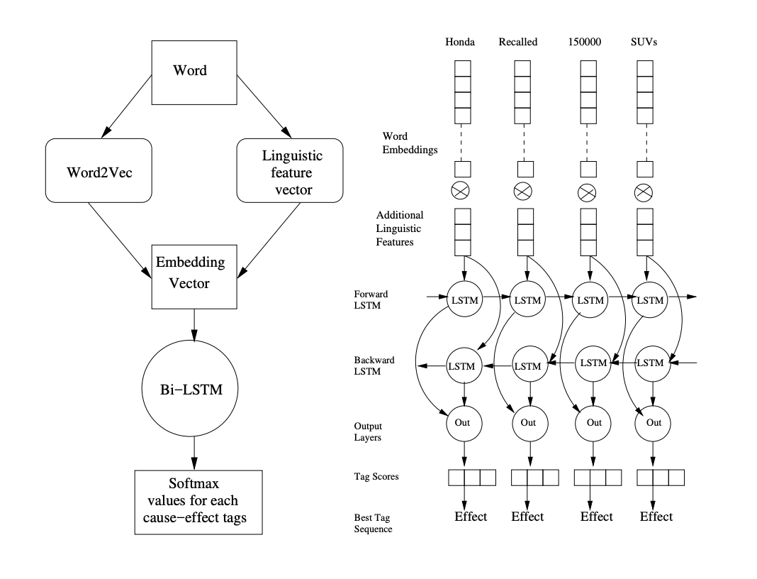
Learning causal relations
Cause - effect relationships between incidents
The car refused to start since its fuel tank was empty
Aircel files for bankruptcy ove mounting financial trouble

Slide 49
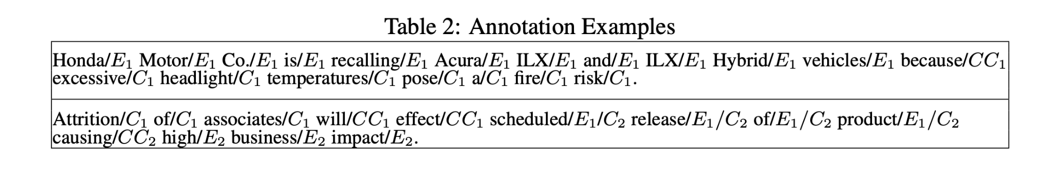
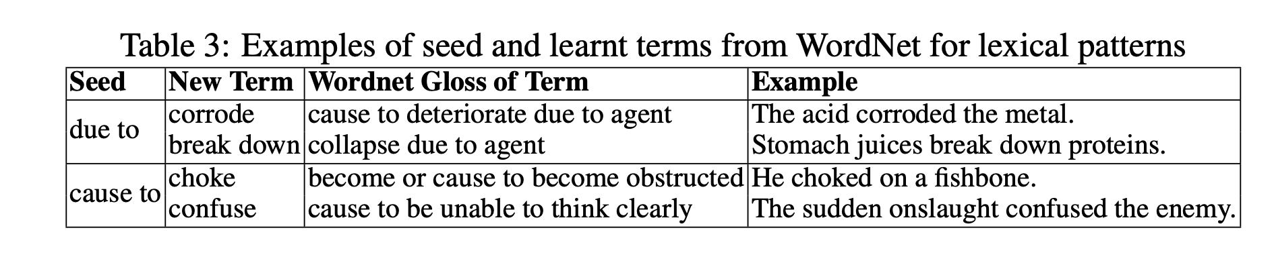
Sequence Labeling Problem

Slide 50
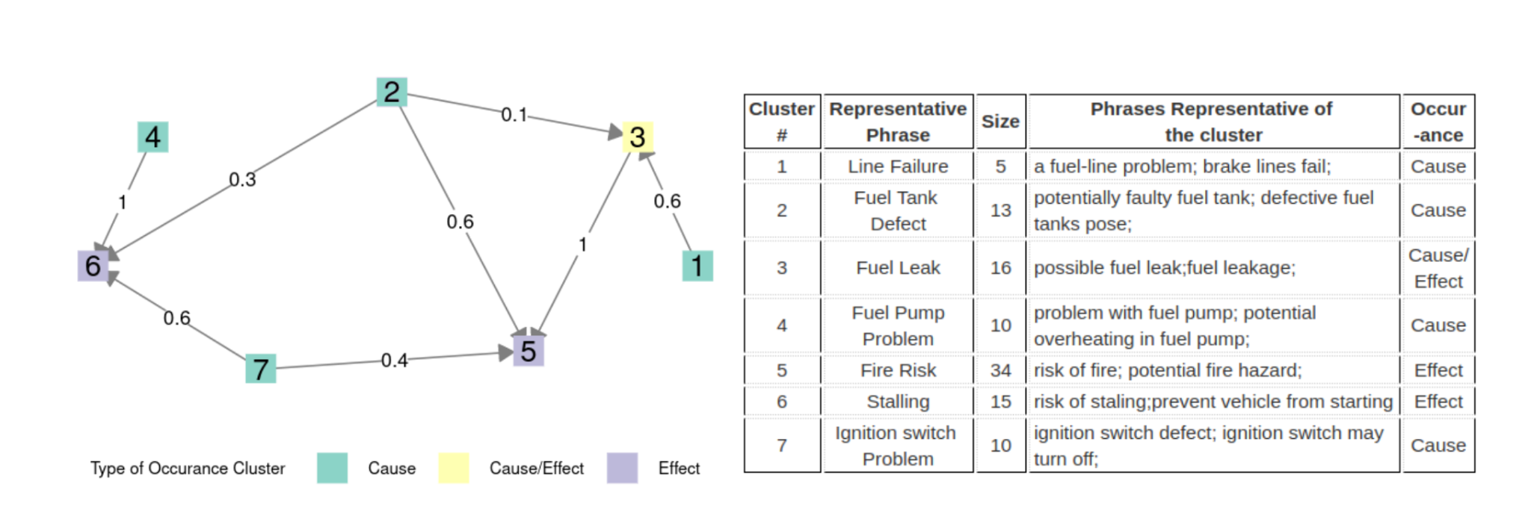
Building causal graph
Clustering of similar phrases

Slide 51
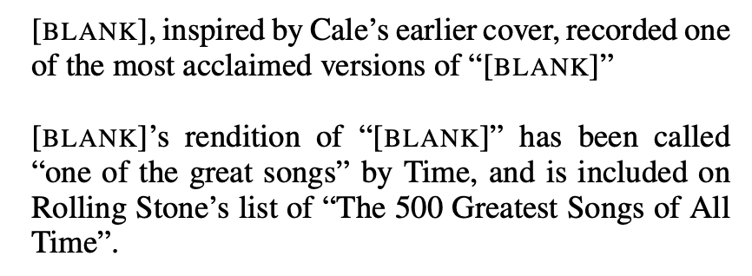
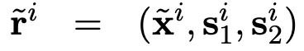
Relation Learning using BERT
x is the tokenized sentence, with s1 and s2 being the spans of the two entities within that sentence
The two relation statements r1 and r2 contain the same entity pair - which have been replaced with the “[BLANK]” symbol
Intuition is that if both r1 and r2 contain the same entity pair (s1 and s2), they should have the same s1-s2 relation
Reference - Livio Baldini Soares, Nicholas FitzGerald, Jeffrey Ling and Tom Kwiatkowski, Matching the Blanks: Distributional Similarity for Relation Learning (https://arxiv.org/pdf/1906.03158.pdf) (2019)

Slide 52
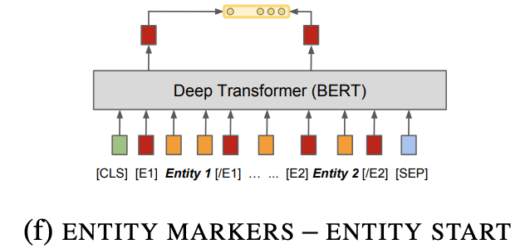
Pre-training BERT to encode relations
Standard BERT architecture is used with slight modifications to encode the input relation statements and to extract their pre-trained output representations for loss calculation & downstream fine-tuning tasks
The output hidden states of BERT at the “[E1]” and “[E2]” token positions are concatenated as the final output representation of x, which is then used along with that from other relation statements for loss calculation, such that the output representations of two relation statements with the same entity pair should have a high inner product

Slide 53
To Summarize
Knowledge Graphs store knowledge in a graph
Nodes represent entities - Relations stored in Edges - relations have semantic interpretation
Question Answering - retrieving the right sub-graph
involves NL interpretation and transformation / translation
Creating KGs automatically
Need NLP for text documents
Relation extraction and classification
R
E2
E1
E1
E2
E2

